Slide 1


GRIND & CRUMB
THE MILLION-
POUND QUESTION
£1.11M SALES
£47.8K LOSS
Why is the busiest café losing money—and why did the app lose orders?
TEAM HONOURABLE • 180 DEGREES × ENACTUS × TECHVISION
Notes:
PRESENTER: AHMED (0:00–0:25). Say: ‘Imagine running your busiest café, generating over £1.1 million in sales, but losing almost £48,000. Then imagine your new app seeing a third of monthly sales disappear after a redesign. That is our £1.5 million decision.’ Pause after each large number. Do not say the whole chain is loss-making.

Slide 2


GRIND & CRUMB / TEAM HONOURABLE
EXECUTIVE DIAGNOSIS • 02 / 09
13 WARNING SIGNS.
2 DECISIONS.
PRIORITY 01
Flagship economics
Piccadilly loses £47.8k despite £1.11m of sales.
PRIORITY 02
Direct app recovery
Own-app sales fell 33.1% from February to March.
THE OTHER ELEVEN
Delivery fees • Leeds overlap • Oat surcharge • Staffing • Waste
Customer sentiment • Seasonal trade • Delayed profit • Data quality
Chain stores remain profitable overall (£1.07m); we are fixing critical weak points.
Notes:
PRESENTER: AHMED (0:25–0:55). Say: ‘We examined thirteen issues, from delivery fees and overproduction to poor staffing and delayed reports. We focus on two high-impact decisions: rescuing the flagship’s economics and restoring direct ordering. Our dashboard keeps the other eleven visible.’

Slide 3


GRIND & CRUMB / TEAM HONOURABLE
PROBLEM 01 / RENT • 03 / 09
THE BUSIEST CAFE
IS THE ONLY LOSS-MAKER
£1.11M
Annual sales • Manchester Piccadilly
−£47,828
Annual store-level operating result
40.2% OF REVENUE IS RENT + RATES
£366k base rent + £80.5k rates = £446.5k
Source: starter_store_monthly_pnl.csv and stores.csv | FY Jul 2025–Jun 2026
Notes:
PRESENTER: ABIMBOLA (0:55–1:30). Say: ‘Piccadilly is our highest-revenue store but its occupancy costs consume 40.2% of sales—£446,520 in rent and rates. It loses £47,828 at store operating level. The issue is not demand alone; it is the cost of this location.’

Slide 4


GRIND & CRUMB / TEAM HONOURABLE
SOLUTION 01 / PROPERTY • 04 / 09
MAKE THE SITE
EARN ITS RENT.
FIRST: NEGOTIATE
15% base rent reduction
£54.9k annual saving; current loss turns into ~£7.1k profit if other factors stay unchanged.
THEN: TEST UNUSED SPACE
Trial B2B pop-ups / evening hires and a commuter-focused grab-and-go format—only if lease and station permissions allow.
Human impact: protect lunch staffing; reduce queues without pushing costs onto baristas.
Lease test, not a guaranteed saving
A property strategy is not the same as the dashboard: the tool shows the problem and tests options.
Notes:
PRESENTER: ABIMBOLA (1:30–2:05). Say: ‘We propose beginning with lease terms and a 15% base-rent negotiation, which is a £54,900 annual saving scenario. If successful, this turns the current loss into about £7,100 profit. We would also test permitted evening event hires, pop-ups and a more efficient grab-and-go configuration, while protecting busy lunch shifts. These are contingent options; we need permission, costs and a commercial pilot.’

Slide 5

GRIND & CRUMB / TEAM HONOURABLE
PROBLEM 02 / APP • 05 / 09
DOWNLOADS
ARE NOT ORDERS.
CHAIN-WIDE OWN-APP SALES
FEB 2026
£95,176
App v3.0 shipped 2 March 2026. Customers reported checkout failures and missing loyalty stamps.
MAR 2026
£63,666
−33.1% MONTH-ON-MONTH
Checkout crashes • Lost rewards • Order-ahead complaints
Caution: February double-stamps promotion ended, so not all decline can be attributed to v3.0.
Source: daily_store_sales.csv, business_events.csv, interviews & reviews | Feb–Mar 2026
Notes:
PRESENTER: LOUIS (2:05–2:40). Say: ‘The app’s redesign was meant to improve engagement, yet customers reported checkout failures and missing rewards. Own-app sales went from £95k in February to £64k in March, a 33.1% fall. February had a double-stamps promotion, so we cannot blame the entire decline on the launch—but technical complaints are an urgent fix.’

Slide 6
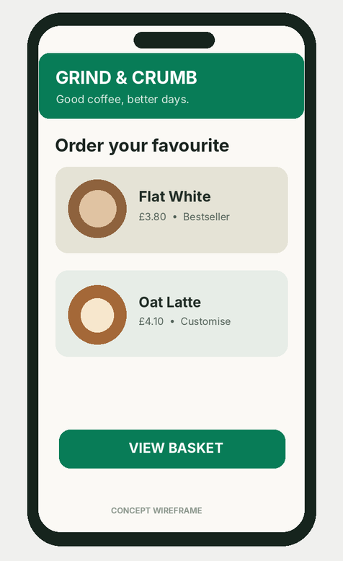
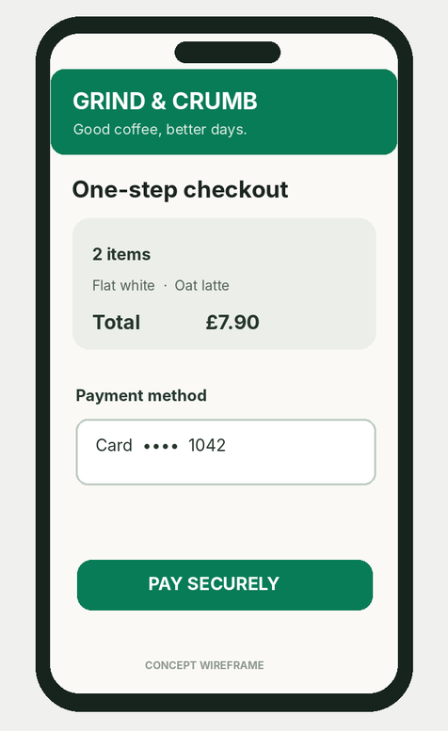
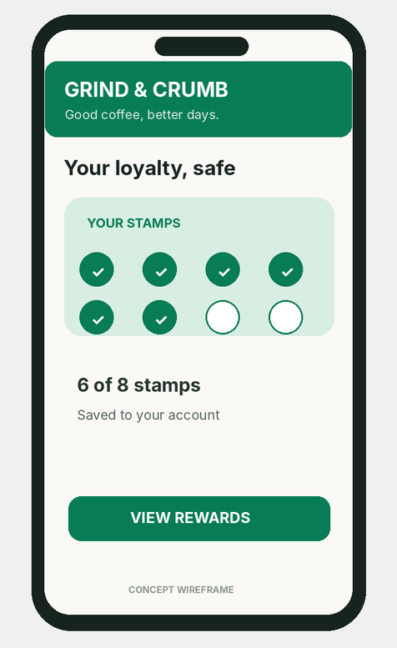
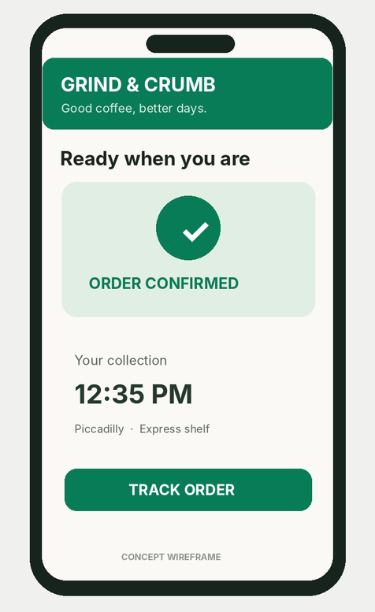
GRIND & CRUMB / TEAM HONOURABLE
SOLUTION 02 / CONSUMERS • 06 / 09
BETTER COFFEE. LESS FRICTION.
01 FIND IT FAST
02 CHECK OUT
03 KEEP REWARDS
04 COLLECT EASY
Reliable checkout comes first. Loyalty and order tracking must work—not just look good.
Illustrative consumer-app concept | Production requires payment, order and rewards integration.
Notes:
PRESENTER: LOUIS (2:40–3:20). Say: ‘Our app concept keeps the journey simple: find your coffee, pay securely, see your stamps and collect without queuing. The first priority is reliable checkout and restored rewards, then smoother order-ahead and transparent tracking. We test completed orders, repeat purchases and contribution, not downloads.’ The screenshots shown are concept wireframes, not a deployed application.

Slide 7
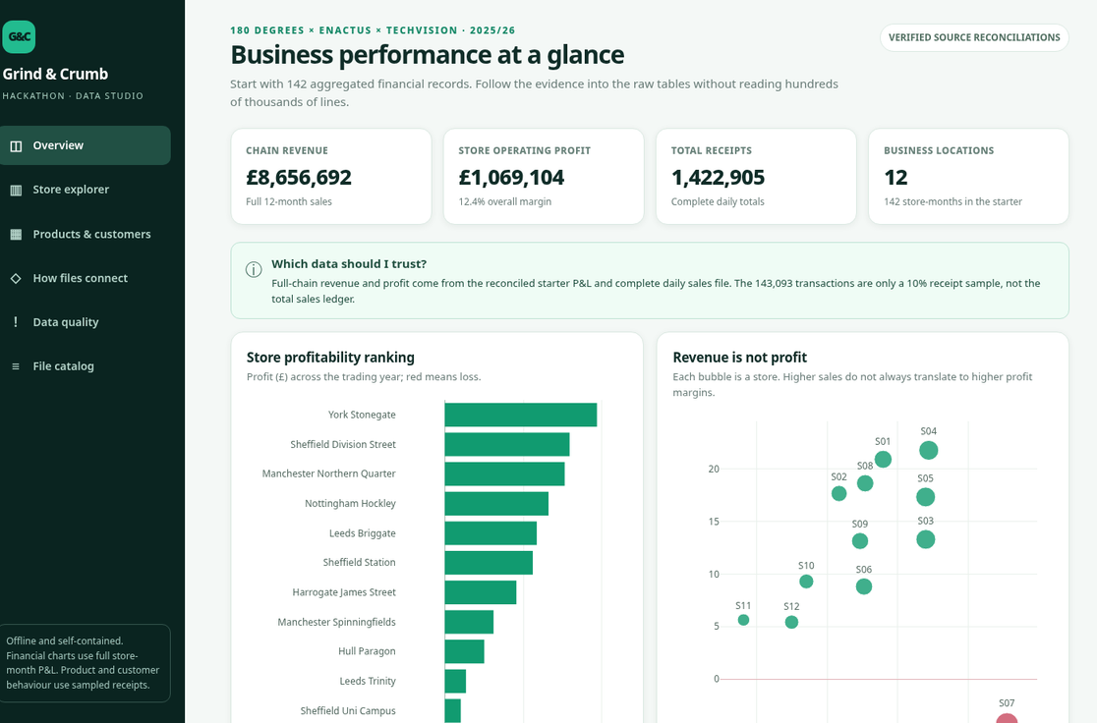
GRIND & CRUMB / TEAM HONOURABLE
TWO PRODUCTS, ONE SYSTEM • 07 / 09
SEE THE LEAK.
FIX THE EXPERIENCE.
CEO + Operations
Profit, rent, delivery and waste by store
Customer App
Checkout, loyalty and order-ahead recovery
The dashboard measures change. The app creates better direct-order experiences.
MANAGEMENT DASHBOARD • ILLUSTRATIVE PROTOTYPE
Verified metrics are drawn from case records; live data refresh would need a production pipeline.
Notes:
PRESENTER: MOHAMMED (3:20–3:55). Say: ‘The two customer experiences meet in one reporting loop. An operations dashboard shows store margin, rent, labour, delivery fees and waste. It is how the CEO tests whether the lease change helps. At the same time, the app creates better direct orders and feeds completion and repeat-customer indicators back to management. The screenshot is an illustrative prototype of the analytics experience.’

Slide 8
GRIND & CRUMB / TEAM HONOURABLE
FUNDING THE TURNAROUND • 08 / 09
WHERE THE £1.5M GOES
£780K
£345K
£375K
CORE TRANSFORMATION
OPERATIONS & LOYALTY
CONDITIONAL RESERVE
Consumer app £400k
CEO dashboard £180k
Piccadilly property £200k
Lunch staffing £150k
Waste + repairs £100k
Delivery £70k | Research £25k
Release only after tested
results, budget reviews and
confirmed implementation costs
STAGED SPEND → MEASURE PAYBACK → RELEASE NEXT FUNDING
Illustrative planning allowances (not supplier quotes); £1.5m includes £375k retained reserve.
Notes:
PRESENTER: MOHAMMED (3:55–4:45). Say: ‘We recommend allocating £780,000 to app recovery, the dashboard and the Piccadilly property strategy; £345,000 to staffing, waste, delivery and customer tests; and £375,000 as a conditional reserve. These are spending allowances, not verified quotations or promised returns. We release funds in stages after measurable tests, so the business does not repeat the same expansion-first mistakes.’

Slide 9
GRIND & CRUMB / TEAM HONOURABLE
FIX THE LEAKS.
THEN GROW.
30 DAYS
60 DAYS
90 DAYS
Verify lease & app baseline
Pilot fixes and track economics
Scale what actually works
OUR ASK: invest in profitable stores, a trustworthy app, and decisions backed by evidence.
AHMED • ABIMBOLA • LOUIS • MOHAMMED
Notes:
PRESENTER: AHMED (4:45–5:00). Say: ‘In 90 days, verify the baseline, pilot our fixes, and scale only what proves profitable. Fix the leaks, restore trust, and then grow. Thank you.’ END. Backup slides follow; do not present unless asked.

Slide 10
GRIND & CRUMB / TEAM HONOURABLE
Q&A BACKUP / 11 ISSUES • 10 / 09
WE DID NOT IGNORE THE OTHER ELEVEN.
Delivery commissions
Order-level contribution; pilot minimum baskets
Sheffield summer losses
Seasonal hours against avoidable expenses
Leeds Trinity / Briggate
Combined Leeds profit; pause expansion decisions
Briggate overproduction
Local, demand-led par levels
Oat milk charge
Test fairer price versus frequency and margin
Customer satisfaction
Segment reviews and track repeat buying
Lunch staffing / churn
Protect peak coverage, monitor staff turnover
Six-week profit delay
Weekly finance scorecard; reconciled monthly
Hull repairs / waste
Test demand-based prep and equipment ROI
Dirty source records
Validate joins, dates, refunds and duplicates
Spinningfields trade
Test weekend opening contribution
Backup slide — not included in the 5-minute spoken presentation.
Notes:
BACKUP ONLY. Eleven nonfocus issues can be grouped by people, stores, customers and data. Explain which are quick-win pilots and which need stronger causal evidence before investing.

Slide 11
Q&A BACKUP / ASSUMPTIONS
DEFEND EVERY NUMBER.
Rent scenario
15% × £366,000 base rent = £54,900 saving per year.
−£47,828 + £54,900 = +£7,072 operating profit.
App scenario
£95,176 (February) vs £63,666 (March) = 33.1% drop.
February included a double-stamps promotion.
Budget and ROI
£1.5m budget is an allocation, not an achieved return.
Release funding by milestones; do not add overlapping upsides.
Source: Grind & Crumb case data, stakeholder reports and Team 4 planning assumptions.
Notes:
BACKUP ONLY. For rent use 15% of base rent (£366,000), not 15% of rent plus rates. For app note confounding February promotion. Total budget allocation is £1.5m, with a £375k reserve. Chain-level 12.35% operating margin excludes head-office costs and taxes.

